Slide 1
GF GPU

Slide 2
Problem Description
Disk systems fail and we need a way to be Fault Tolerant.
Naive solution is to have multiple copies of data.
To be Fault Tolerant to any 2 disk failures, we need 3 copies of every disk.
Erasure Codes trade time for space.
Some codes need to use Galois Fields to work properly.
Galois Fields allow for addition and multiplication on a finite set of elements.

Slide 3
Problem Description (Reed-Solomon Codes)
1
D0
D0
1
D1
D1
X
=
1
D2
D2
1
D3
D3
C0
C1

Slide 4
Problem Description (Reed-Solomon Codes)
Suppose we lose 2 disks.
1
D0
D0
1
D1
XX
X
=
1
D2
D2
1
D3
XX
C0
C1

Slide 5
Problem Description (Reed-Solomon Codes)
We can recover like this.
-1
D0
1
D0
D1
1
D2
=
X
D2
C0
D3
C1

Slide 6
Serial Solution
1101
x 0111
1101
11010
110100
Suppose we're using 4-bit words and we want to multiply 13 by 7.

Slide 7
Serial Solution
1101
x 0111
1101
11010
⊕ 110100
First, do a Carry-Less Multiply.

Slide 8
Serial Solution
1101
x 0111
1101
11010
⊕ 110100
100011
But now our answer has 6-bits.

Slide 9
Serial Solution
So we reduce with an Irreducible Polynomial.
So 13 x 7 = 5 in our 4-bit Galois Field.
1101
x 0111
1101
11010
⊕ 110100
100011
⊕ 10011
101

Slide 10
Serial Solution
That technique is called SHIFT.
We also implemented 6 other techniques:
  LOG TABLE
  TABLE
  SPLIT TABLE
  GROUP
  BYTWO_b
  BYTWO_p

Slide 11
Serial Solution (SHIFT)
GF_Mult(a, b):
Answer = 0
For i = 0 to w-1:
If the i-th bit of a is set:
Answer ^= b << i
For i = 2w-2 down to w:
If the i-th bit of answer is set:
Answer ^= IP << i
Return Answer

Slide 12
Related Work
There aren't any existing parallel solutions that we found.
We used GF-Complete library as a reference.
GF-Complete uses Intel's SSE instructions for vectorization.

Slide 13
Parallelization Strategy
There are no data dependencies so each thread handles a single data element at a time.
Kernel is nearly identical to the serial solution.

Slide 14
Parallel Optimizations
Used shared memory to hold tables for faster lookup times
Loop unrolling with #pragma unroll
Reduce number of accesses to global and shared memory
Attempted using calculations to avoid divergent if/else blocks

Slide 15
Parallel Optimizations
Using more complex bitwise calculation to avoid divergence did not help
if(prod & pmask)
prod = (prod << 1) ^ IP08;
else
prod <<= 1;
prod = (prod << 1) ^ (IP08 & (sprod >> 7));

Slide 16
Parallel Optimization
Caching set bits instead of bit-shifting slowed performance for small word sizes
num_bits = 0;
for(int i=0; i<8; ++i)
if(1 << i&c)
set_bits[num_bits++] = i;

Slide 17
Evaluation
CPU version run on Intel Core i7 3770 @ 3.4Ghz
GPU version run on Tesla C2050
Used 50MB of data on word sizes 8, 16, and 32

Slide 18
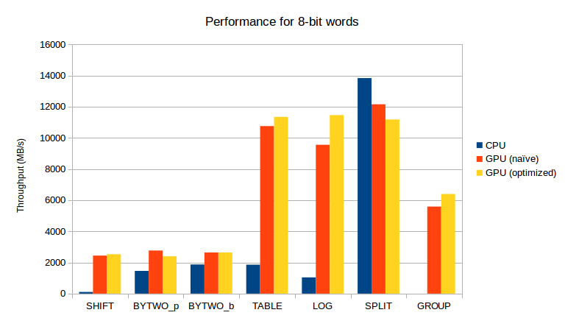
Evaluation

Slide 19
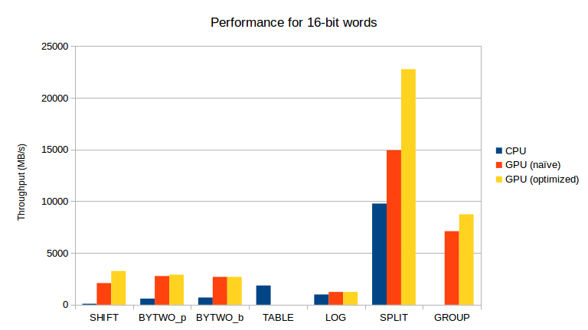
Evaluation

Slide 20
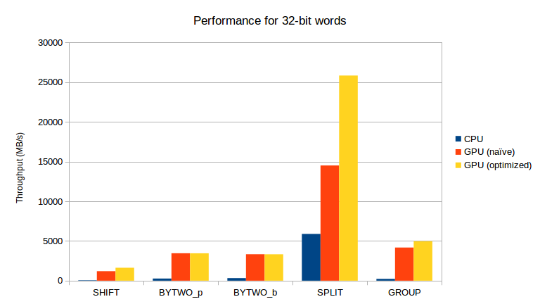
Evaluation

Slide 21
Conclusion
Working GPU version similar to GF-Complete
Higher throughput than CPU in most cases
Room for improvements such as multiple GPU setup or streaming of data to GPU

